Slide 1
Session and Application Management
Session Management
<number>/23

Slide 2
Objectives
Session introduction
Session management mechanism
  Cookie
  URL Rewrite
HttpSession
Hidden form field
Manage sharing data with ServletContext
  Init context parameters
Session Management
<number>/23

Slide 3
Session introduction
Session refers to the time you spend on a site.
Session is a mechanism to temporarily store each individual client's data during interaction with the webserver
The session starts at the first request of the client and ends when the session is terminated or no request is received for a certain period of time (session timeout).
Session is actually a memory allocation on the server dedicated to each client managed by the web server
Session is a solution to overcome the stateless feature of HTTP
Bài giảng dành cho sinh viên Công nghệ Thông tin

Slide 4
Session management
Session data storage mechanism:
  Save client data separately on the server
  Each client session is assigned a session ID.
Client session on server map to client’s browser by 2 techniques:
  Cookies
  URL Rewriting
Some kind of individual client data store on session:
  Shopping cart
  Searchable list of books..
Bài giảng dành cho sinh viên Công nghệ Thông tin
Notes:
https://www.digitalocean.com/community/tutorials/java-session-management-servlet-httpsession-url-rewriting

Slide 5
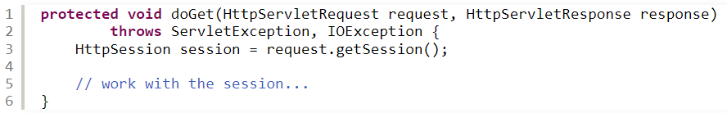
Session management
By default, a session is automatically created when the user visits the website.
Session Management
<number>/23

Slide 6
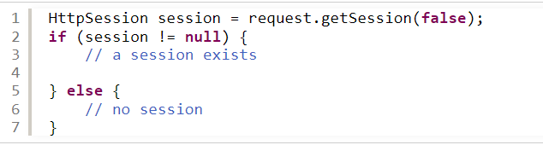
Session management
Note: the HttpServletRequest .getSession() method returns the current session associated with the request, or create a new one if the request doesn’t have a session. That means the returned HttpSession object is always not null.
To get a session without creating a new one if not exist, you can use invoke getSession(false) on the HttpServletRequest:
Session Management
<number>/23

Slide 7

Binding Data to a Session
To store a value in a session, use the method setAttribute(key, value) of the HttpSession object.
Session Management
<number>/23
Notes:
Here, the key is username and value is Daniel Tran. Data stored in a session is managed by the server and will be deleted when the session ends.
You can store any kind of object in the session. For example, the following code stores a List of Student objects in the session:
NOTES:
Each user is associated with different HttpSession object, so the values stored for user #1 are different than the values stored for user #2 - although the key is the same.
If the key is already associated with a value, then the old value is replaced by the new one. So you can use the setAttribute() method to update value in the session.

Slide 8
Read value from session in Java Servlet or JSP
To get value from a session, use the getAttribute(key) method of the HttpSession object.
Session Management
<number>/23
Notes:
Note that the getAttribute(key) method will return null value if the given key is not found in the session.

Slide 9
Remove value from session
To delete a value associated with a key from the session, use the removeAttribute(key) method.
Session Management
<number>/23
Notes:
By default, a session is destroyed only after the user has been idle for a timeout period. In case you want to destroy an individual session immediately, call the invalidate() method like this:
1
session.invalidate();
This removes any objects bound to the session and destroy it.

Slide 10
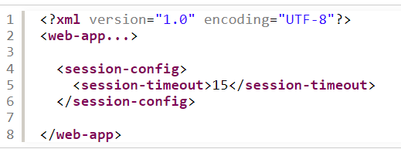
Configure Session Timeout
Each server has different default value for global session timeout, e.g. 30 minutes in Apache Tomcat.
Set session timeout for an individual web application by modifying its web deployment descriptor file (web.xml).
Session Management
<number>/23
Notes:
By default, a session is destroyed only after the user has been idle for a timeout period. In case you want to destroy an individual session immediately, call the invalidate() method like this:
1
session.invalidate();
This removes any objects bound to the session and destroy it.

Slide 11
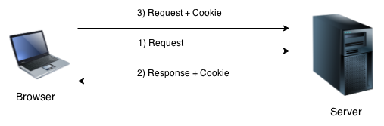
Cookies
Cookies are used to uniquely identify a client computer, used for session management
  Cookies are sent by server to client web browser, saved by the browser, and then sent back to the server on the next request. SessionID store in cookie help to identify the specific client.
  In Java web applications, the cookie returned has a standard name JSESSIONID and store in memory.
  Persistent cookies remain on a computer indefinitely
Session Management
<number>/23

Slide 12
Cookies
Create cookie:
  Cookie(String name, String value)
  setMaxAge(int expiry)
  Sets the maximum age of the cookie in seconds.
  public String getName()
  Returns the name of the cookie.
  public String getValue()
  Returns the value of the cookie.
HttpServletResponse.addCookie(javax.servlet.http.Cookie)
HttpServletRequest.getCookies() return Cookie[]
Session Management
<number>/23

Slide 13
URL Rewriting
URL rewriting is a process of modifying URL structure while loading a page, when cookie is not allowed on client computer
A “pseudo-parameter” called jsessionid is placed in the URL before the query string.
Example:
http://localhost:8080/demo/update;jsessionid= 58112645388D9380808A726A27F92997?name=value
SessionID is passed to server in every request by URL rewrite.
HttpServletResponse.encodeURL(url)
Session Management
<number>/23

Slide 14
HttpSession
Servlet API use HttpSession for session management of Java web server
  Impicit object session in JSP pages
  Automatically created by server (session=“true”)
  Obtain session by request.getSession()
Session methods
  public void setAttribute(String name, Object attribute)
  public Object getAttribute(String name)
  public void removeAttribute(String name)
  public void invalidate( )
  public void setMaxInactiveInterval(int interval)
Bài giảng dành cho sinh viên Công nghệ Thông tin

Slide 15
Session setting in web.xml
Time-out : The time-out value is controlled in one of three ways:
  Application Server Global Default
  Web Application Default
    <web-app>
    <session-config>
    <session-timeout>60</session-timeout>
    </session-config>
    </web-app>
  Individual Session Setting
    On obtaining a session, can set the time-out value for that individual session only using the HttpSession.setMaxInactiveInterval(int seconds)
    An interval value of zero or less indicates that the session should never timeout.
Session Management
<number>/23

Slide 16
Session tracking by hidden form
Hidden form field is used to store session information of a client.
<input type=“hidden” name=“user” value=“xxx”>
  Even if the cookies are disabled, form filed will work perfectly
  Anonymous session tracking
  Information is stored in client browser, so it increases the security
  works only for a sequence of dynamically generated forms
Session Management
<number>/23

Slide 17
ServletContext with share data
A web container can manage any number of distinct applications. An application consists of any number of servlets, filters, listeners, and static Web pages. A set of components working together is a Web application.
The container uses a context to group related components. The container loads the objects within a context as a group, and objects within the same context can easily share data.
Each context usually corresponds to a distinct Web application.
Data stored in ServletContext accessible to application
Session Management
<number>/23

Slide 18
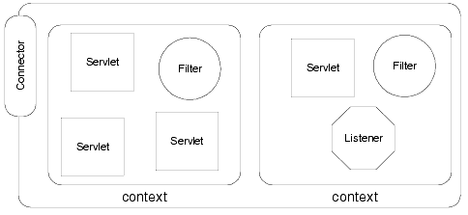
ServletContext
Session Management
<number>/23

Slide 19
ServletContext
Obtained by request.getServletContext()
Implicit object application in JSP pages
  Store share data for the whole application
  Link to web-server resource
Useful methods
  public void setAttribute(String name, Object attribute)
  public Object getAttribute(String name)
  public String getInitParameter(String name)
  public String getRealPath(String path)
  public void log(String message)
  public void removeAttribute(String name)
Bài giảng dành cho sinh viên Công nghệ Thông tin

Slide 20
ServletContext Initialization Parameters
Init parameters are fundamental information available to all the dynamic resources (servlets, JSPs) within your web application.
Be declared in web.xml with <context-param> or by method setInitParameter(name, value);
ServletContext.getInitParameter(paramName);
<web-app>
  <context-param>
      <param-name>machineName</param-name>
      <param-value>GERALDINE</param-value
  </context-param>
</web-app>
Session Management
<number>/23

Slide 21
Summary
  Session concept
  Session Management
  Cookie
  URL Rewrite
  HttpSession
  Hidden form field
  ServletContext
  Init parameters
  Share data with context
Session Management
<number>/23

Slide 22
Constructivity questions
A voting page wants to prevent users from voting multiple times with F5 key. Provide a solution for this.
Where should hit counter for a page be installed?
Where should the user's shopping cart be stored?
Find examples of information should be declared as the application's init parameter
Can a user create multiple sessions to a web application at the same time?
Is it possible to copy the URL of a logged-in user to another computer's browser to view the information of the same session? Explain why?
Session Management
<number>/23

